Slide 1
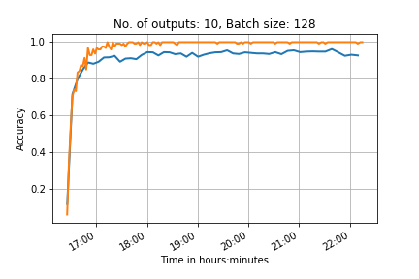
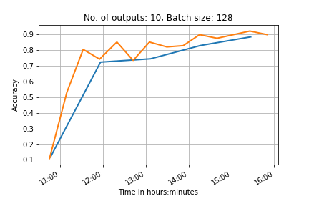
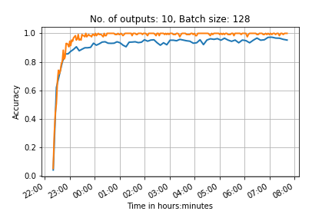
4 convolution layers
2 convolution layers, many outputs on each one
10 outputs
6 convolution layers

Slide 2
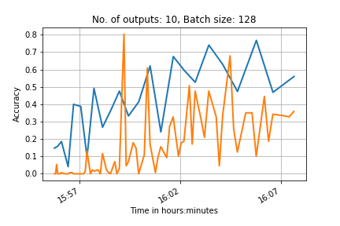
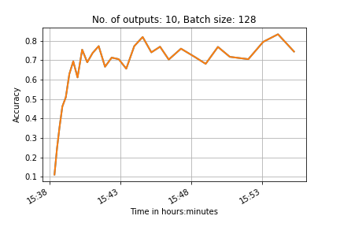
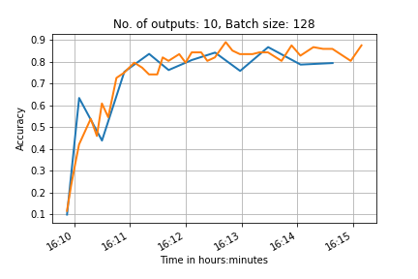
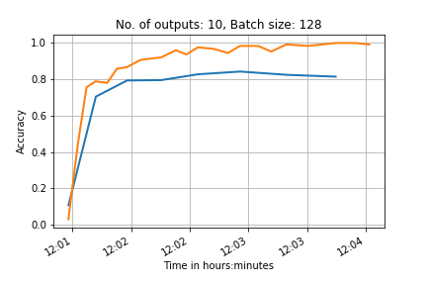
No shuffling
With shuffling
10 outputs,
Simple network
Normalised data
Advanced normalisation (and shuffled test data)

Slide 3
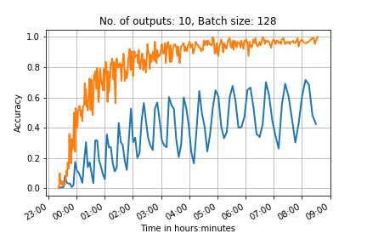
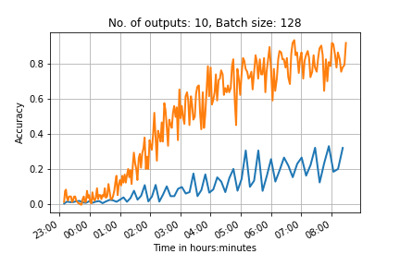
100 outputs
2 convolutional network, test batch 500
6 convolutional network test batch 1000
0.95(*10000) steps
0.65(*10000) steps
Learning rate too high?
Increase the drop out layer to prevent overfitting to the training data?
If we compare this to the previous network we expect it to have a testing accuracy of ~0.5 when it ends

Slide 4
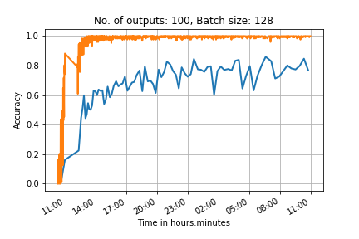
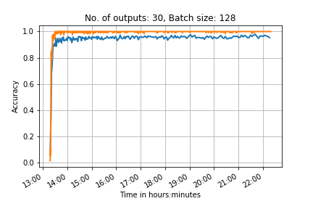
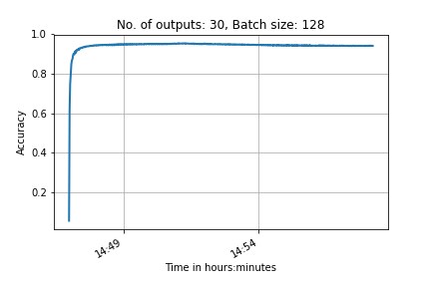
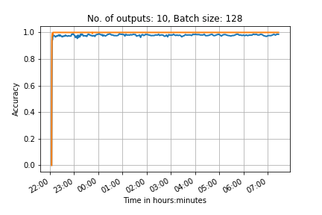
PRINT
CNN with 2 Convolutional layers and 2 fully connected layers
Transfer

Slide 5
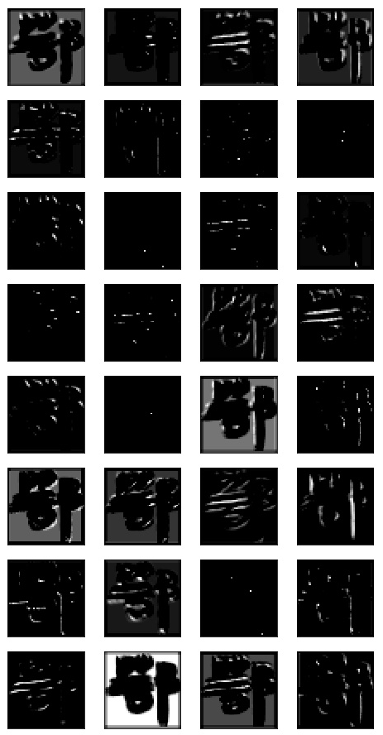
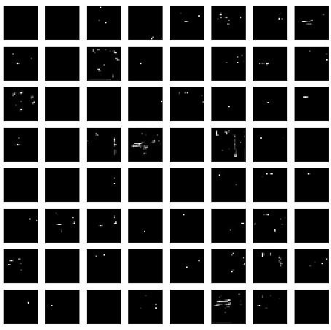
1st layer activations
2nd layer activations
Feature maps from convolutional layers from network trained on 100 classes from scratch
PRINT

Slide 6
References
Feature maps
https://arxiv.org/pdf/1507.02313.pdf

